Slide 1
CSCI 598 – Professional Writing and Communication for Computer Scientists
CLASS 14

Slide 2
Clarifications
Writing Assignment 3
Final draft due by noon on May 1
Make-up presentations April 28 – 8:30am
There is no third presentation, only slides submitted in WA3
All assignments must be completed for course credit by May 1

Slide 3
Visual Aids
Death by PowerPoint:
https://www.youtube.com/watch?v=KbSPPFYxx3o

Slide 4
Writing Assignment 3

Slide 5
Writing Assignment 3
SITUATION
You’re nearing the end of your internship. Mary Moreno, your supervisor, is very impressed with your work and has recommended that you be brought back after you graduate from USC. She thinks you have a bright future.
As your final project as an intern, you have been asked to participate in your company’s “Blue Sky” thinking initiative. This is a chance to suggest directions and applications for your company that are out of the mainstream of thinking. (In research terminology, “Blue Sky Research” suggests that valuable research can have unforeseen results.) The initiative’s goal is for your company to have a positive impact on an issue facing society. While you might not completely “solve” a problem, at the very least you can use the company’s strengths to engage that problem.

Slide 6
Mary and her superiors feel you’re the perfect person to make this proposal because of your previous examination of ethics and your enthusiasm for computer science. Because of your knowledge of IT issues and their possible impact (via the second writing assignment), you are even more qualified to make some good suggestions.
The proposal should focus on an important social issue in your home country or a country you feel is in need of new thinking. This could be anything: homelessness, childhood obesity, an apathetic citizenry, the environment, domestic violence, racism, the digital divide… any social issue you find important.

Slide 7
As an example, you might propose that Google joins in the fight against childhood obesity. The idea includes some thoughts of how the company could promote the cause via its graphics, how they could compile relevant statistics, how they might promote healthier diet options via analytics…that sort of thing. You should also utilize your insights as a programmer.
As your “final project” for them, prepare a brief proposal that concisely and persuasively discusses an idea for your company to address. The expectation is that your suggestions will be “out of the box” and only limited by good intensions and potential impact. This is the dream stage – blue sky thinking where anything is possible.

Slide 8
There are two components to this assignment:
A memo
Sample presentation slides
You are to write an informative and persuasive proposal to your supervisor (which, if approved, will be passed on to the company’s leadership). Your goal is to introduce your “blue sky” idea and show its possibilities. Details of implementation are not necessary at this time.

Slide 9
Your memo should include:
A summary paragraph of your proposal.
An examination of the social issue and its impact on your home country or any country of interest.
A brief summary of an article or website on the topic (to provide context and support for your proposal).
The identification and discussion of your bold idea of what innovations you would like to see implemented.
How the social issue and its effects will be impacted by the innovation (and, hence, your company). How will this benefit the company in the end?
A closing paragraph that summarizes the excitement and importance of your proposal.

Slide 10
A few notes:
The memo should be no more than three pages and should be addressed to Mary Moreno.
Focus on writing clear, concise paragraphs.
Don’t go into great detail. Keep it simple.
The memo and slides are due via the course dropbox by 12:00pm on May 1.

Slide 11
Assignments Specifics:
Due via course dropbox by 12:00pm on May 1
Include Statement of Originality
Word limit of 750 words
Use the posted memo format

Slide 12
Main Criteria for Success:
Proposal
Opening Summary/Rationale
Identification of Social Issue
Inclusion and Summary of Supporting Article, Book, or Website
Description of Impact to Society and Company (Focus on Impact, Not Technology)
Examples of Application of Technology
Clarity
Conciseness/Directness
Audience-appropriate Tone

Slide 13
Main Criteria for Success:
Also, you will be asked to give a presentation in support of your proposal. Your supervisor would like to see your PowerPoint (or other program) slides to make sure you’re on the right path. Submit 5 slides (not including your title slide) that you would use to present your idea.

Slide 14
Main Criteria for Success:
PowerPoint Slides
Visual Interest
Use of White Space
Not Overwhelming Text
Consistency
Progression of Ideas
Knowledge of Topic Apart from Presentation

Slide 15
You have 5 slides…
What should be covered?
Purpose
Audience
Structure

Slide 16
Samples

Slide 17
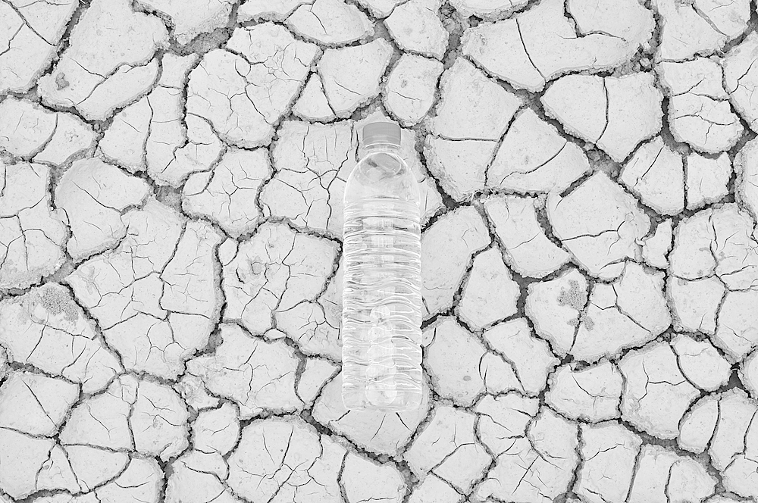
WATER CRISIS

Slide 18
INTRODUCTION
“A water crisis is a situation where the available potable, unpolluted water within a region is less than that region's demand.”

Slide 19
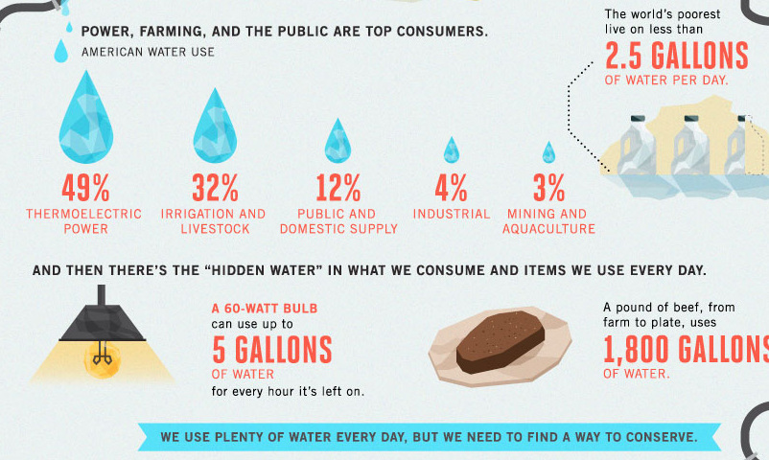

Slide 20
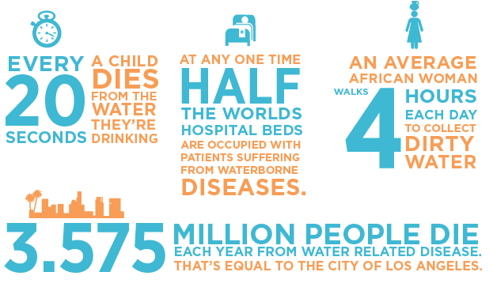
ISSUE

Slide 21
IMPACT
Increase in global dispute
Lack of usable water
Food shortages
Energy shortages

Slide 22
RECOMMENDATIONS
Raise awareness to change consumption and lifestyles
Innovate new water conservation technologies
Recycle waste water
Improve water irrigation techniques
Develop energy efficient desalination plants
Look to community-based governance and partnerships
Address pollution

Slide 23
THANK YOU
Let’s make a better future.

Slide 24
Use of Images
Guided by Titles

Slide 25
Prevent Crime of Violence
via Google Map
Proposal for “Blue Sky”

Slide 26
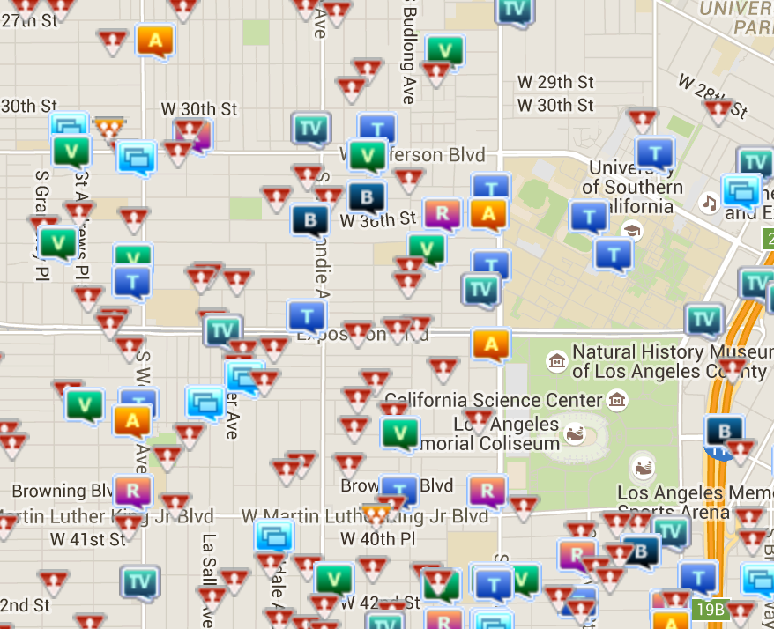
Social Issue - Violence

Slide 27
Social Issue - Violence

Slide 28
Proposal
Security
Mode
Google
Map
Real-time
Alert
Big Data
Predict
Security Mode

Slide 29
Proposal
Security
Mode
Google
Map
Real-time
Alert
Big Data
Predict
Real-time Alert

Slide 30
Proposal
Security
Mode
Google
Map
Real-time
Alert
Big Data
Prediction
Big Data Prediction

Slide 31
Support
Crime and Modernization - The Impact of Industrialization and Urbanization on Crime

Slide 32
Progression of Ideas

Slide 33
Internet of Things System in Gun Control
-- Blue Sky Research

Slide 34
Shooting in San Bernardino
At about 11 a.m. on Dec. 2rd, 2015
Inland Regional Center, San Bernardino, CA
14 people dead

Slide 35
Shooting Issue
1 people killed / 2.9 days
Influence:
For a family, loss of dear relatives
For society, an terrifying atmosphere

Slide 36
Implement of IoT
Offer IoT System to Weapon Shops
Register the Bullets and Guns
Forbid Weapon Purchase from Illegal Source
Alert Police when Weapon in Public
Privacy Protect

Slide 37
Rebut Doubts
Weapon is special -> Managed specially
Responsibility
Encryption and Strict Permission -> Protect the privacy

Slide 38
Effects
Manage the weapons
Prevent shooting in advance
Track criminal after shooting
Less frequent of shooting and abuse of guns

Slide 39
Progression of Ideas

Slide 40
FACEBOOK solving OBESITY issue.
By Xxxxx.

Slide 41
Intensity of an OBESITY ISSUE.
As per WHO (World Health Organization) More than 1.9 Billion adults are found overweight in year 2014. Out of these, 600million were obese.
The rate of increase in issue is found to be 30% more in developing countries as compare to developed countries.
Common health consequence of obesity:
i) Leads to heart attacks, one of the leading reasons of the deaths in 2012.
ii) Diabetes etc.

Slide 42
Causes and analysis of an issue…
An excessive intake of fat-dense food.
Significant decrease in physical activity.
Medication.
Psychological factors.
etc….
The bright side is obesity is PREVENTIBLE And potentially FACEBOOK can do a lot to make this PREVENTION happen.

Slide 43
Proposed Solution…
I propose following comprehensive 3step accumulative plan:
Step1:
Start the “awareness program” regarding obesity issue.
Step2:
Provide a “Daily Schedule Tracking system” to each user
Step3:
Do continuous statistical analysis.

Slide 44
FACEBOOK in collaboration with WHO(World Health Organization), this campaign will definitely put a step forward positively in a war against obesity.

Slide 45
Amount of Text

Slide 46
“Blue Sky” proposal

Slide 47
Air pollution:

Slide 48
Social issue:
Owing to the fact that with the development of our society we have to solve more and more problem about the environment, because of our human-being make great damage on the environment, which is not only bad for our human health, but also very bad for the ecosystem, so I have a “Blue Sky” thinking which is we can pure the water and sky in a most efficient way also there are some efficient way for us to detect factory’s discharge of poisonous gas into sky

Slide 49
international impact.
If we can deal with it, we can have a good way to prohibit those factory which our government prohibit them to not to discharge poisonous gas but they still discharge. So I think this proposal can have great social impact.

Slide 50
context :
The emergence of great factories and consumption of immense quantities of coal gave rise to unprecedented air pollution and the large volume of industrial chemical discharges added to the growing load of untreated human waste. water pollution caused by bad sanitation, and street pollution caused by the 3 million horses who worked in American cities in 1900, generating large quantities of urine and manure.

Slide 51
Innovation:
machine that include software and hardware which we can use to detect the factory which that discharge poisonous gas, when they discharge we can in the first time detect the place, which factory discharge, we can quickly get the position of the factory, so in this way we can decrease the pollution of the factory to the sky to the lowest level.

Slide 52
Summary:
If we can have the innovation, I think many company would not dear to discharge the poisonous anymore, which can be not only good to the whole society, but also it is good for the ecosystem. So I think this can help a lot for us to create a better society and more harmonious society.

Slide 53
What is Emphasis?

Slide 54

Aiding the Dyslexic Children
--A “Blue Sky” Proposal

Slide 55
What is dyslexia?
· Also known as reading disorder
· Trouble with reading despite normal intelligence
· Actual problems including reading, writing,
social relationship, etc.

Slide 56
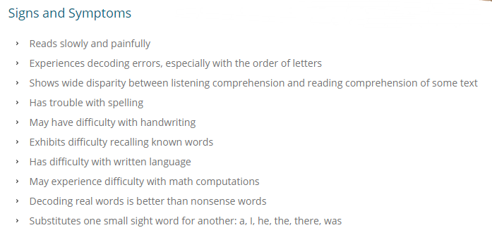
What is dyslexia?

Slide 57
Why it’s serious?
Dyslexic children are often…
· Physically and socially immature in comparison to their peers
· Misunderstand as “bright but not hard-working”
· Tend to make many “careless” or “stupid” mistakes, which is extremely frustrating to them

Slide 58
Why dyslexic children to help?
We can
· Resources(corpus), technologies(NLP)
We should
· With proper guidance, same talent and potential as others
We care
· Better life for both majority and disadvantaged minorities

Slide 59
What can we do to help?
· Propaganda
· Provide dyslexic-friendly educational materials
· Provide the opportunity for them to get treated online

Slide 60
Thank you.

Slide 61
Audience Benefits

Slide 62



Slide 63
Problem at hand
Crime rates on the rise year over year.
Low response time of the concerned authorities during crimes.
Impossible for authorities to have physical presence at all times in all places.
America has more violence than other countries like Japan and Canada.
Violent crimes committed have increased last year.
Overall crime rate increased in 2015 compared to previous years according to the FBI

Slide 64
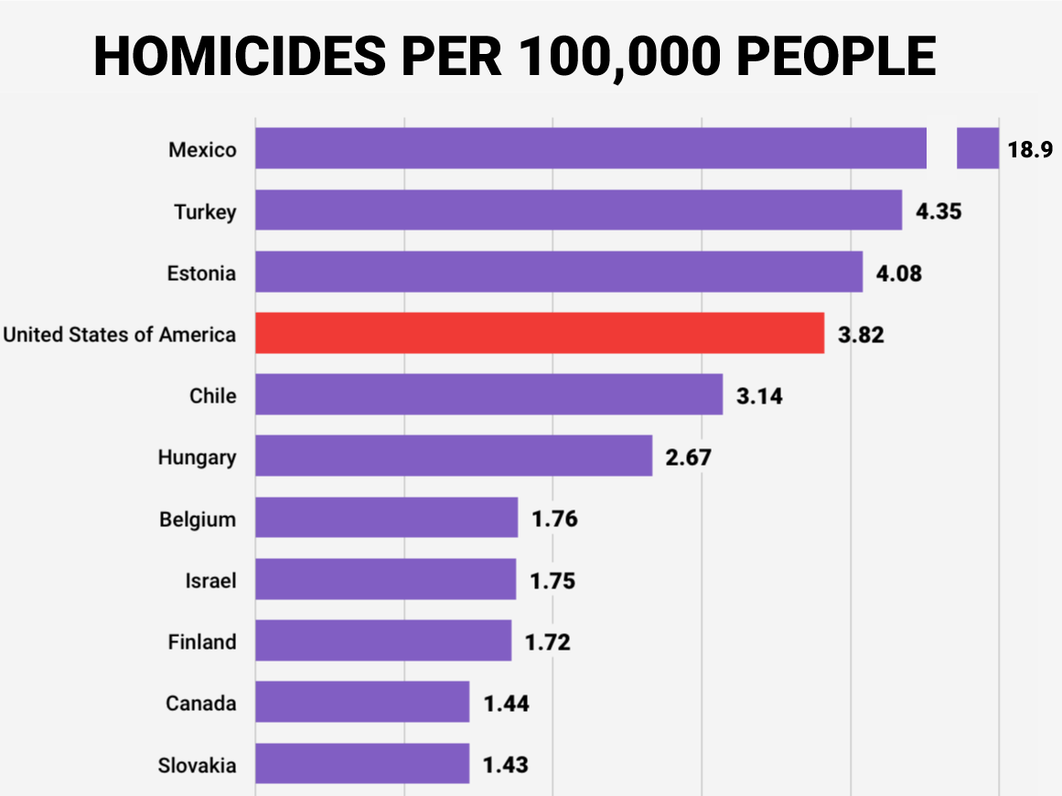
Source : Business Insider

Slide 65
What can Google do ?
Develop intelligent systems to analyze and predict crime patterns.
Use publicly available audio and video feeds to achieve this.
Employees at Google always want to make the society better via technology.
Develop new analytics algorithms.
Advanced image and video processing algorithms need to be in place.
Need to explain to the people this is not cause any security or privacy issues.

Slide 66
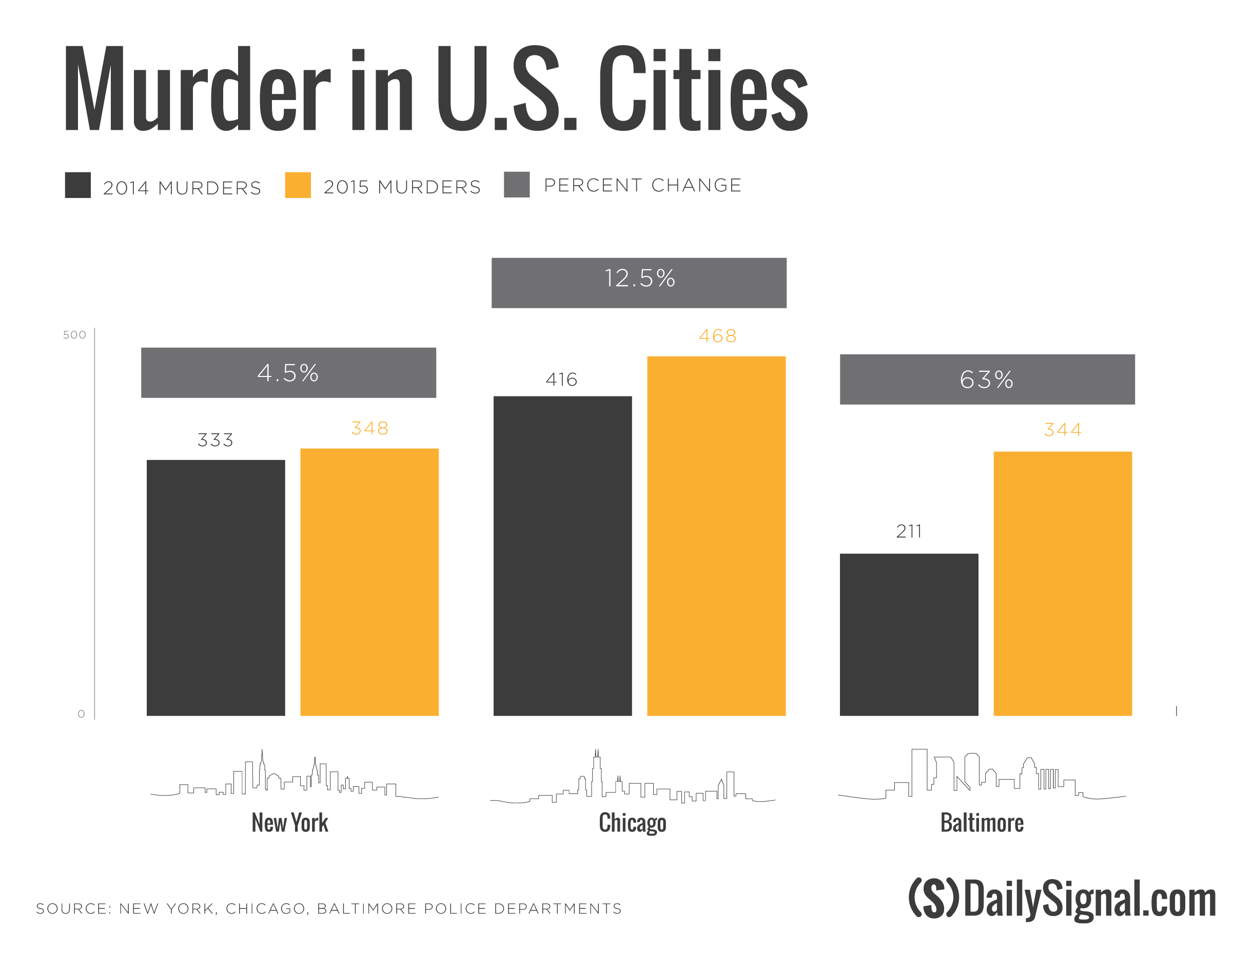

Slide 67

Projected drop in crime rates when solution in place

Slide 68

Projected increase in response time when solution in place

Slide 69
How will Google benefit ?
Will help public and the authorities.
Will increase trust and admiration among public.
Will strengthen the “highly innovative” tag associated with Google.
Will ensure Google is ahead of it's competition in terms of innovation and social impact

Slide 70
Start with Conclusion

Slide 71
The Digital Connect

Slide 72
Introduction
India has made a name for itself for its technological feats and great innovations being performed by its people in this technological era .
hidden issue which is not come to light is the problems faced by the people in rural India, people who are still technologically backward due to “Digital Divide”
They use age old methods for information sharing like the postal service and using obsolete methods in the education system.

Slide 73
Key ideas in Digital Connect
Team up with our customers and come up with a plan
Advertise stating that for every adapter that is purchased from our firm a percentage of that business will be used for this movement
Funding the purchase of computers and telephones and setting up the network infrastructure in these technologically backward rural areas

Slide 74
The Endless Possibilities
Solve various problems Like:
Illiteracy
Unemployment
Poverty

Slide 75
The Endless Possibilities Continued..
Improved Methods of Agriculture using scientific methods from the Internet
Enhanced Irrigation Methods
Improved methods of Communication
Newer methods of education using World Wide Web
Provide new employment opportunities

Slide 76
Conclusion
Solving the “Digital Divide” issue is the main aim of this movement and it will create a great impact on the society
We as technological innovators owe it to the society in bringing a change in these people’s lives and thereby connecting the world.

Slide 77
Use of Pathos

Slide 78
Towards a Greener Earth
- XXXXXX

Slide 79
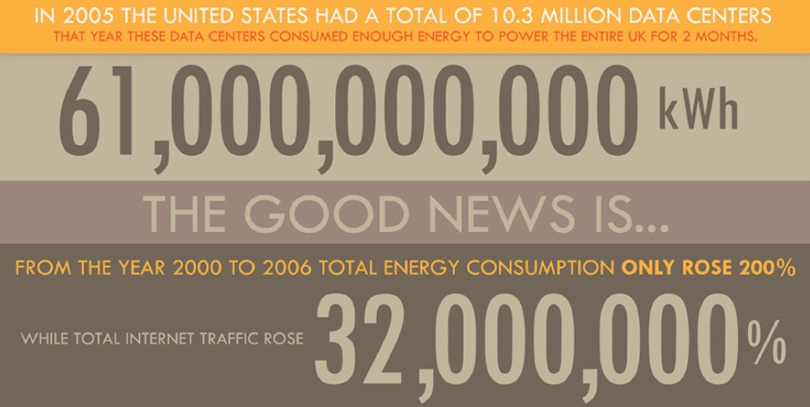
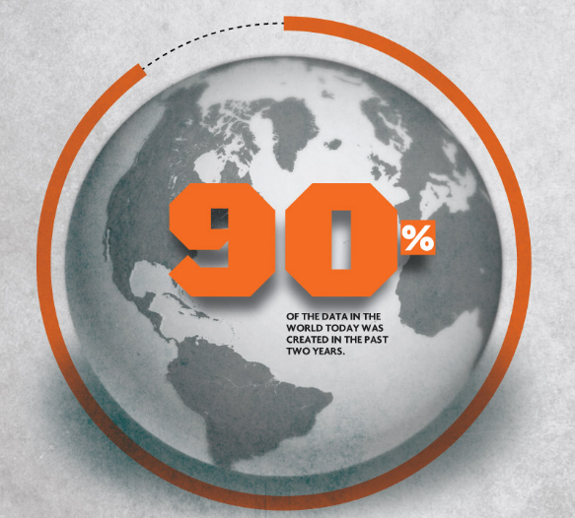
Connected World

Slide 80

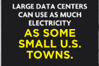




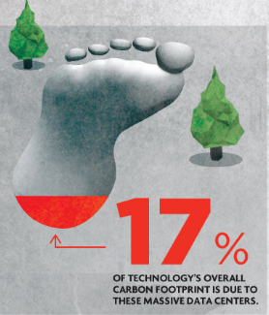
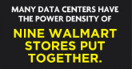
Impact of our Growth

Slide 81
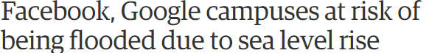
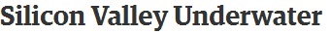
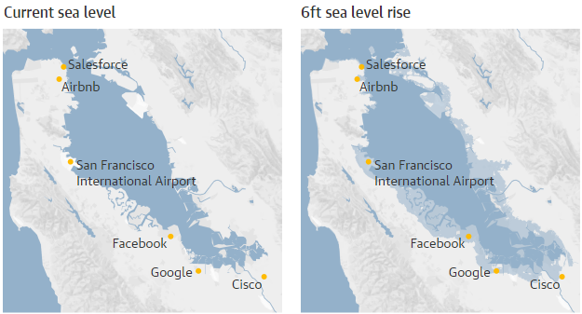
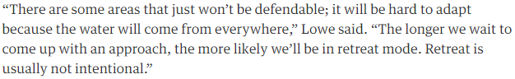
Impact of Our Growth

Slide 82

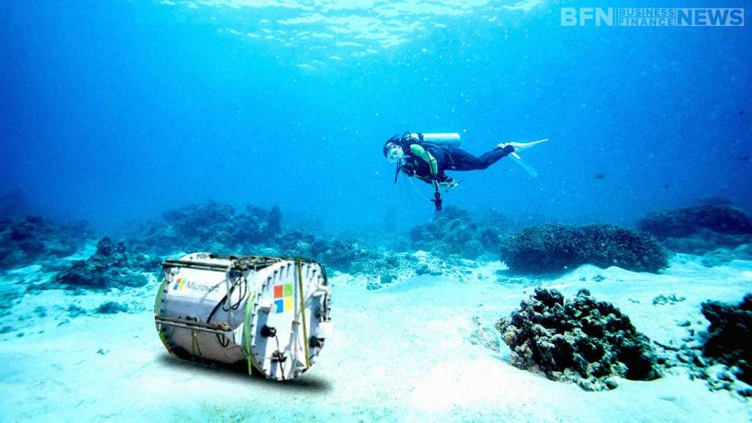
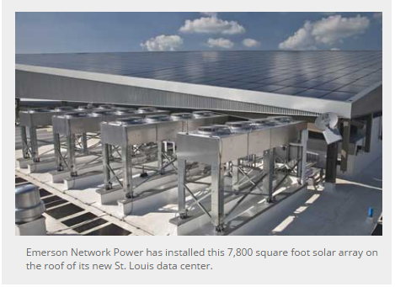
Using Environment to Our Advantage

Slide 83
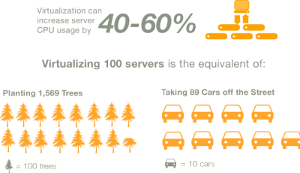

Efficient Resource Usage

Slide 84
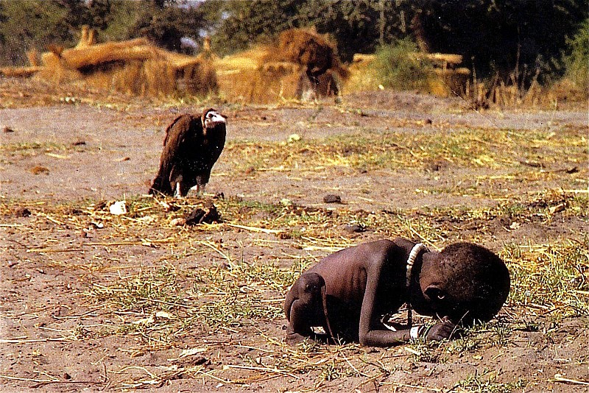
Thank You
Start before its too late

Slide 85
Next Week
Final Class

